Slide 1
Collaborative Filtering

Slide 2
Memory Based Algorithm
Similarity weight:
Spearman Correlation
Vector Similarity
Mean-square-difference
Variance Weighting
Selecting Neighbors:
Rating Normalization: prediction

Slide 3


Similarity weight
Weight all users with respect to similarity with the active user:
Spearson Rank correlation
Vector Similarity
Mean Squared difference Algorithm
(Ux-Uy)^2

Slide 4


Variance Weighting
We hypothesized that giving the distinguishing movies more influence in determining a correlation would improve the accuracy of the prediction algorithm.
We modified the previous algorithm to incorporate an item-variance weight factor.
Previous algorithm
After variance weighting

Slide 5
Selecting Neighborhoods
Absolute Correlation Threshold
All neighbors with absolute correlations greater than a given threshold are selected
Best n correlates for a given n
Choose the n highest similarity neighbors
Combining the two algorithms

Slide 6

Prediction
Rating normalization using z scores:

Slide 7
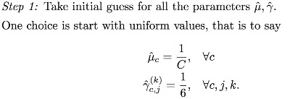
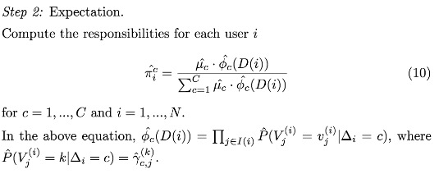
Model based algorithm
Cluster Models

Slide 8
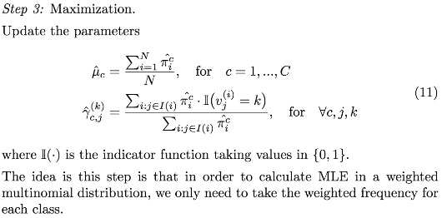


Slide 9
Performance Metrics (data set1)
Similarity weight | Variance weight | Selecting Neighbors | ROC | MAE | Ranked Scores
spearman | no | Best n
spearman | no | Absolutethreshold
spearman | no | combined
spearman | no
 | yes
spearman

Slide 10
Performance Metrics (data set2)
Clustering model | Similarity weighting | Variance weighting | Selecting Neighbors | ROC | MAE | Ranked Scoring
Clustering model |  |  |  | 0.7382 | 1.01366

Slide 11
Conclusions

